Slide 1
Cloud Study Jam EDU
bit.ly/EDU_CloudStudyJam2019

Slide 2
How to use these slides
Event organizer, during the event:
Use these slides to drive the agenda during your Cloud Study Jam in-person event.
If you have a projector, pull up the slides on your computer and show them to the audience. Start with the next slide.
If you don’t have a projector, ask your attendees to go to these slides at goo.gl/F6NbFE and follow along.
Attendee, after the event: Use these slides as reminder of what you have done and direction for what you’ll be doing next.

Slide 3
Cloud Study Jam
What is it?
Learn the fundamentals of the Google Cloud Platform, how to run containers on it and how to use the platform for data engineering.
How long does it take?
One in-person session of 4 hours, plus 2-8 hours of self-study.
What is the end result?
Google-hosted badges that you can use in your online profiles.

Slide 4
About Cloud Study Jam

Slide 5
Agenda
Agenda
2h | Introduction to GCP, Complete three GCP Essentials labs together.
15min | Break.
1h 45 mins | Complete fourth lab together, Demo of lab 1 of another quest , Group Discussion Share your photos online with the hashtag #CloudStudyJam19!
At home | Complete the remaining three GCP Essentials labs to earn a badge and an additional month of free Qwiklabs access!
At home | Use your free access to learn and earn badges in Kubernetes, Scientific Data Processing, Deployment Manager, Cloud Architecture, Developing Applications, Data Engineering, or Windows on GCP. You choose!
At home | Share your progress with fellow attendees online. (Facilitator to share online channel for your group).
2h | Introduction to GCP, Complete three GCP Essentials labs together.
15min | Break.
1h 45 mins | Complete fourth lab together, Demo of lab 1 of another quest , Group Discussion Share your photos online with the hashtag #CloudStudyJam!
At home | Complete the remaining three GCP Essentials labs to earn a badge and an additional month of free Qwiklabs access!
At home | Use your free access to learn and earn badges in Kubernetes, Scientific Data Processing, Deployment Manager, Cloud Architecture, Developing Applications, Data Engineering, or Windows on GCP. You choose!
At home | Share your progress with fellow attendees online. (Facilitator to share online channel for your group).

Slide 6
Get Set!

Slide 7
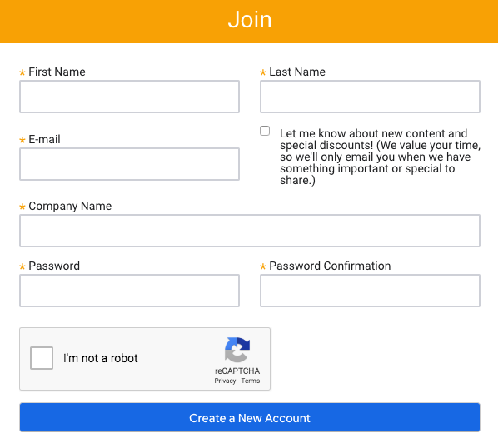
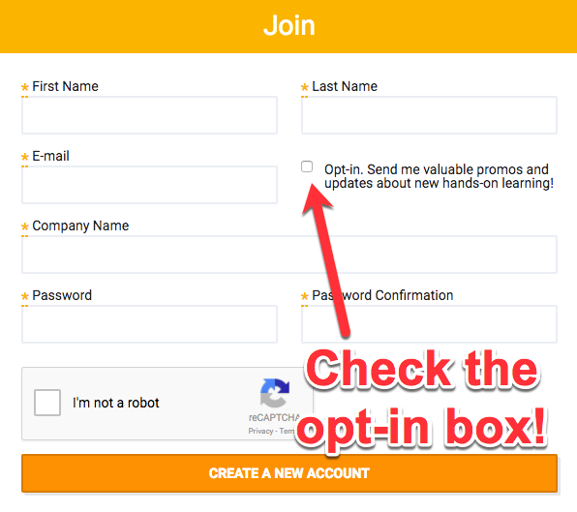
Check the opt-in box
Let’s get started
Go to the link and enter in the unique token provided by your facilitator. This will redeem one month of free access to Qwiklabs.
If you don’t already have a Qwiklabs account, create one now. Make sure you check the opt-in box for promos!
If you already have an account, go to qwiklabs.com/my_account/profile, check the Marketing Opt In box and click the Update User button. That makes you eligible for additional free access after you complete the GCP Essentials quest.

Slide 8
Troubleshooting
If you already have a Qwiklabs account and enrolled in the GCP Essentials quest before, please un-enroll in the quest and then click the Enroll button again. Only when you click the Enroll button will the credit be applied to your account.
If you have already completed the GCP Essentials quest before this event, contact support@qwiklabs.com and they will give you a special code so you get your credit.
If there any other problems, email support@qwiklabs.com. The team there will respond quickly.

Slide 9
Go Cloud!

Slide 10
A Cloud-First World
By 2020 "cloud shift" will affect more than $1 trillion in IT spending.
Gartner
Business demands for agility and innovation prompt rise of cloud native applications: adoption is set to double by 2020
Capgemini
Data Engineering is a crucial new field that bridges gaps between data, insight, and action.
Forrester

Slide 11


What do you aspire to be?
Data Scientist
Data Analyst
Cloud-Native App Developer
Cloud Infrastructure Engineer
Notes:
Traditional roles are evolving in a cloud-first world. New roles in data science and machine learning are emerging.

Slide 12

What is Cloud?
Infrastructure
Platform
Software
>
>
… as a service

Slide 13
Infrastructure as a Service
IaaS
PaaS
SaaS
>
>
Notes:
Infrastructure includes raw resources such as a virtual machines, networking, storage and more. These resources are the fundamental building blocks of cloud computing.
When you consume infrastructure as a service (IaaS) you have greater control over the resources but also greater management overhead. For example, consider a virtual machine. You need to install, upgrade, and patch all the software required to run your application. You can configure your virtual machines to scale based on the load on your application.
Google Compute Engine, networking, and load balancers are examples of IaaS.

Slide 14
Platform as a Service
IaaS
PaaS
SaaS
>
>
Notes:
Platform as a service (PaaS) provides a platform with managed services where runtime environment and network settings are pre-configured. This makes it easier for you to develop and deploy your application.
Google App Engine is an example of PaaS. Google App Engine comes pre-configured with runtimes for Java, Python, Node.js, and more. Software upgrades and patches are automatically applied. Load balancing is also pre-configured. This enables the developer to focus on the application logic only instead of worrying about infrastructure setup.

Slide 15
Software as a Service
IaaS
PaaS
SaaS
>
>
Notes:
With Software as a service (SaaS), entire applications are managed and made available in cloud environment. Gmail is an example of a SaaS.

Slide 16
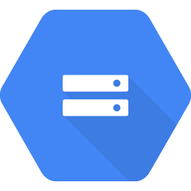
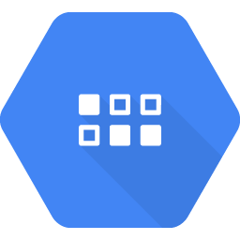
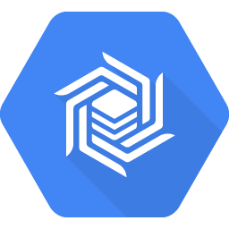
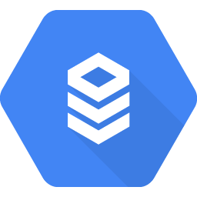
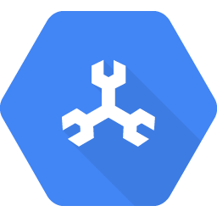
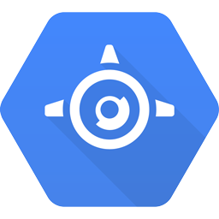
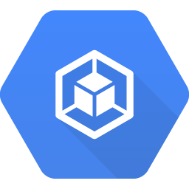
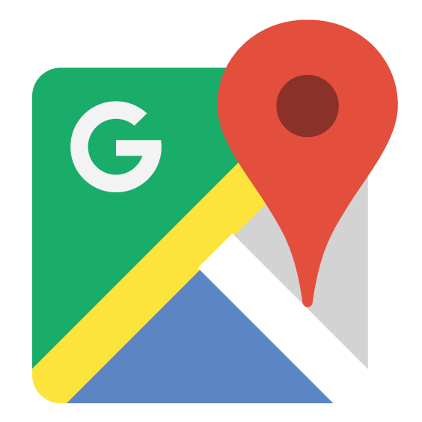

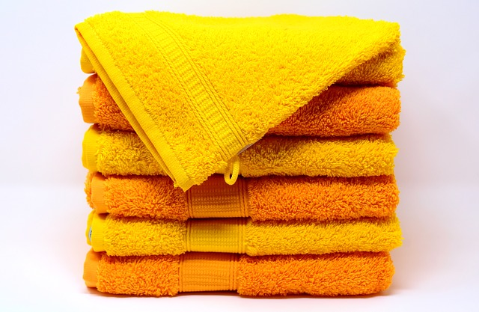
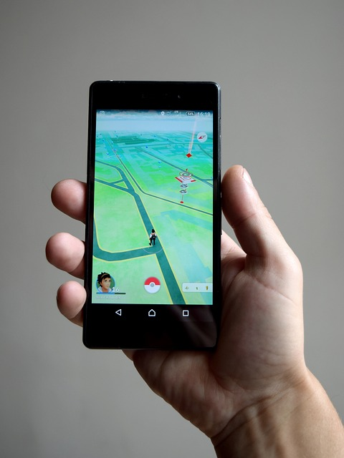
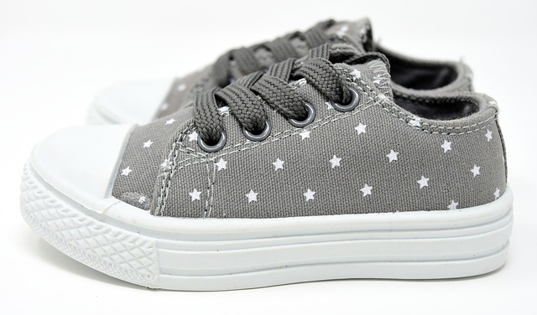
No need to manage your own infrastructure.
Use managed services instead.
Application Data
Application Logic
Integration with other Google services
Cloud Storage
Cloud Datastore
Cloud Bigtable
Cloud
SQL
Cloud Spanner
App Engine
Container Engine
Google Maps, YouTube, and more
CustId
Name
User data management
API gateways for other backend apps
Payment etc.
Object data like multimedia
High-volume or semi-structured data like streaming or gaming data
Relational data
Notes:
This slide shows how you can use Google Cloud Platform for application data, application logic, and integration with other Google services.

Slide 17
Google Cloud Platform Essentials

Slide 18
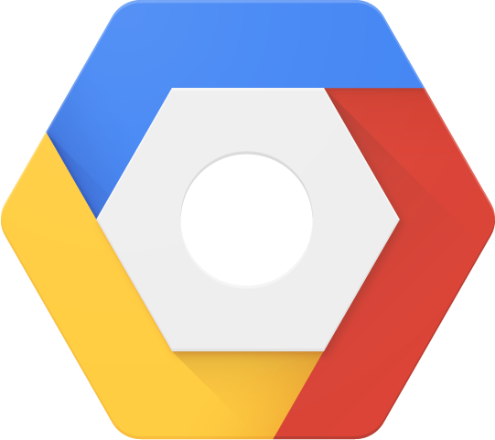
Google Cloud Platform Project
All Google Cloud Platform services are associated with a project that is used to:
Track resource and quota usage
Enable billing
Manage permissions and credentials
Enable services and APIs

Slide 19
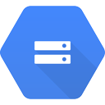
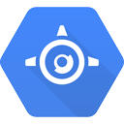

Identity and Access Management
Who
can do what
on which resource
Notes:
The “can do what” part is defined by an IAM role. An IAM role is a collection of permissions. Most of the time to do any meaningful operations you need more than 1 permission. For example to manage instances in a project, you need to create, delete, start, stop and change an instance. So the permissions are grouped together into a role to make it easier to manage.
The “who” part names the user or group to whom the rule is granted. To give a user or group the desired permissions, you grant a role to the user on a resource.

Slide 20
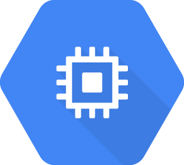
Google Compute Engine
Compute Engine
Virtual machines with predefined or custom machine types:
vCPUs (cores) and Memory (RAM)
Persistent disks: HDD, SSD,and Local SSD
Networking
Linux or Windows

Slide 21
Regions and Zones
Regions: Collections of zones
Specific geographical locations where you can run resources
Regions are interconnected using Google’s global, meshed backbone network
Zones: Isolated deployment areas in a region
Your resources can be regional, zonal, or in some cases multi-regional
Notes:
Regions are independent geographic areas that consist of zones. Locations within regions tend to have round-trip network latencies of under 5ms on the 95th percentile.
A zone is a deployment area for Cloud Platform resources within a region. Zones should be considered a single failure domain within a region. In order to deploy fault-tolerant applications with high availability, you should deploy your applications across multiple zones in a region to help protect against unexpected failures.

Slide 22
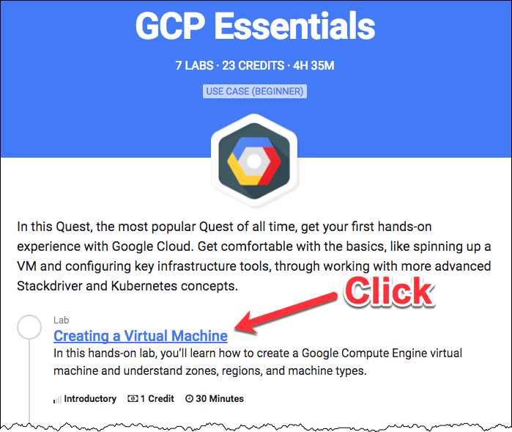
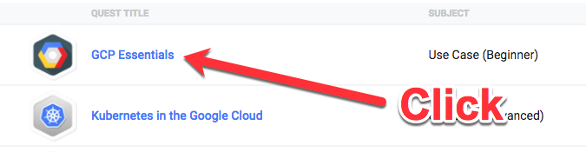
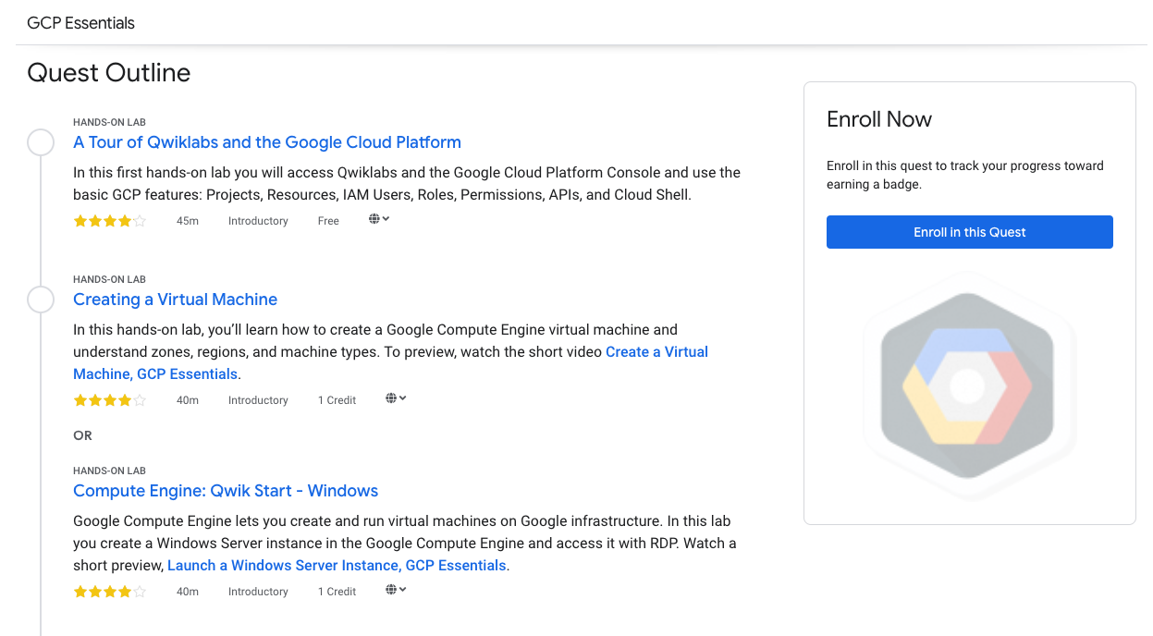
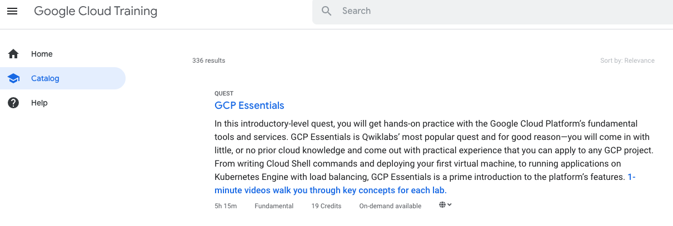
The First Lab
Click
Click
Click the GCP Essentials quest. If you don’t see it, go to google.qwiklabs.com/quests/23
Click the Creating a Virtual Machine link.

Slide 23
Lab 1: Creating a Virtual Machine (GCP Essentials Quest)
Compute Engine
Objectives
Create a virtual machine with the Google Cloud Platform Console.
Create a virtual machine with gcloud command line.
Deploy a web server and connect it to a virtual machine.

Slide 24
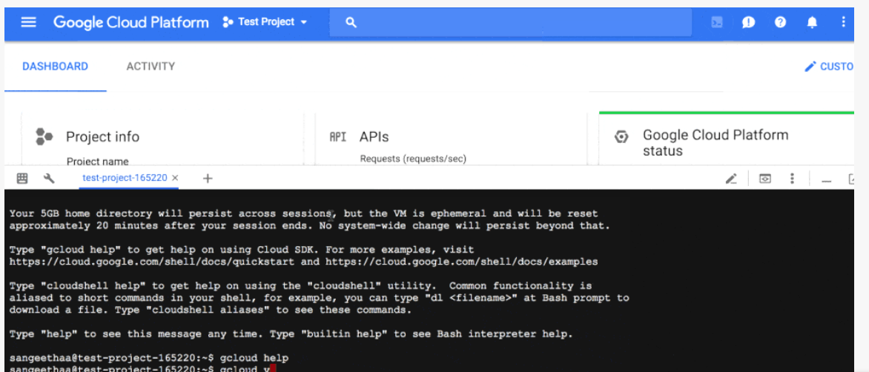
Cloud Shell and gcloud
Cloud Shell is a Debian-based virtual machine which makes it easy for you to manage your Cloud Platform projects and resources.
Pre-installed Google Cloud SDK and other tools
5 GB of persistent disk storage
Cloud Shell provides command-line access to a virtual machine instance in a terminal window that opens in the web console.
Notes:
You can use Google Cloud Shell to:
Create and manage Google Compute Engine instances
Create and access Google Cloud SQL databases
Manage Google Cloud Storage data
Interact with hosted or remote Git repositories, including Google Cloud Source Repositories
Build and deploy Google App Engine applications

Slide 25
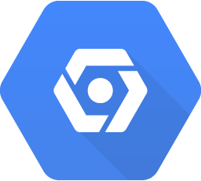
Lab 2: Getting started with Cloud Shell and gcloud (GCP Essentials Quest)
Cloud Shell
Objectives
Connect to computing resources hosted on Google Cloud Platform.
Practice using gcloud commands.

Slide 26

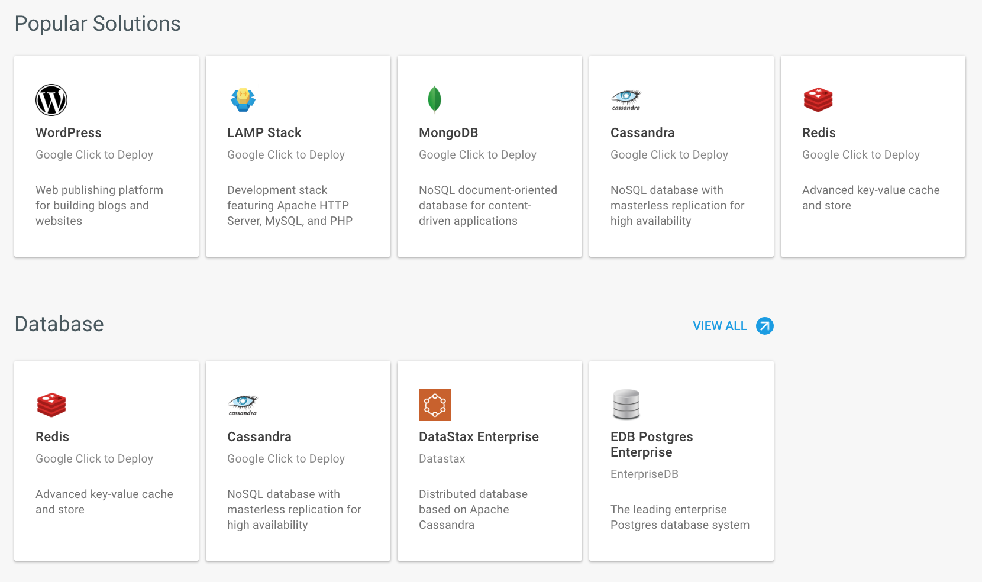
Cloud Launcher
A solution marketplace containing pre-packaged, ready-to-deploy solutions
Some offered by Google
Others by third-party vendors
You pay for the underlying GCP resource usage

Slide 27

Break
Wow, you have done a lot in the Cloud in a short amount of time! You’ve earned a break.
Share with fellow attendees what you found hard or easy in the labs so far.

Slide 28
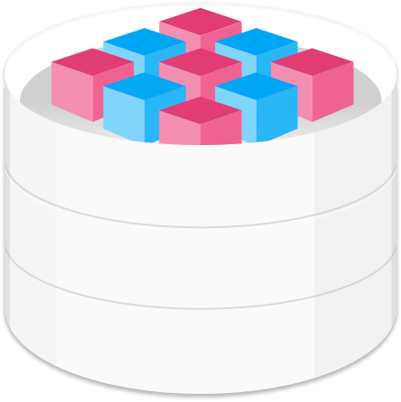

Persistent Disk
Persistent disks are of the following types: Standard, SSD, or local SSD.
Standard and SSD persistent disks scale in performance for each GB of space allocated.
You can resize disks, migrate instances with no downtime.

Slide 29


Lab 3: Provision Services with Cloud Launcher (GCP Essentials Quest)
Replace
Objectives
Launch a common web stack (Nginx) with Cloud Launcher
Verify your deployment

Slide 30
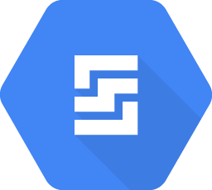
Lab 4: Creating a Persistent Disk
Persistent Disk
Objectives
Create a new VM instance and attach a persistent disk.
Format and mount a persistent disk.

Slide 31
Rent-a-VM to Process Earthquake Data
or Introduction to Docker
Facilitator’s choice
Notes:
Facilitator: Please display slides from the appropriate section depending on the lab you choose.

Slide 32

Lab Demo
Your Facilitator has picked the final lab for demo. It is one of these:
Rent-a-VM to Process Earthquake Data
Find it by going to google.qwiklabs.com/catalog and entering earthquake in the search field at the top of the page.
Introduction to Docker
Find it by going to google.qwiklabs.com/catalog and entering introduction to docker in the search field at the top of the page.
Your Facilitator will walk you through the lab. You can complete both labs at home.

Slide 33
Rent-a-VM to Process Earthquake Data

Slide 34
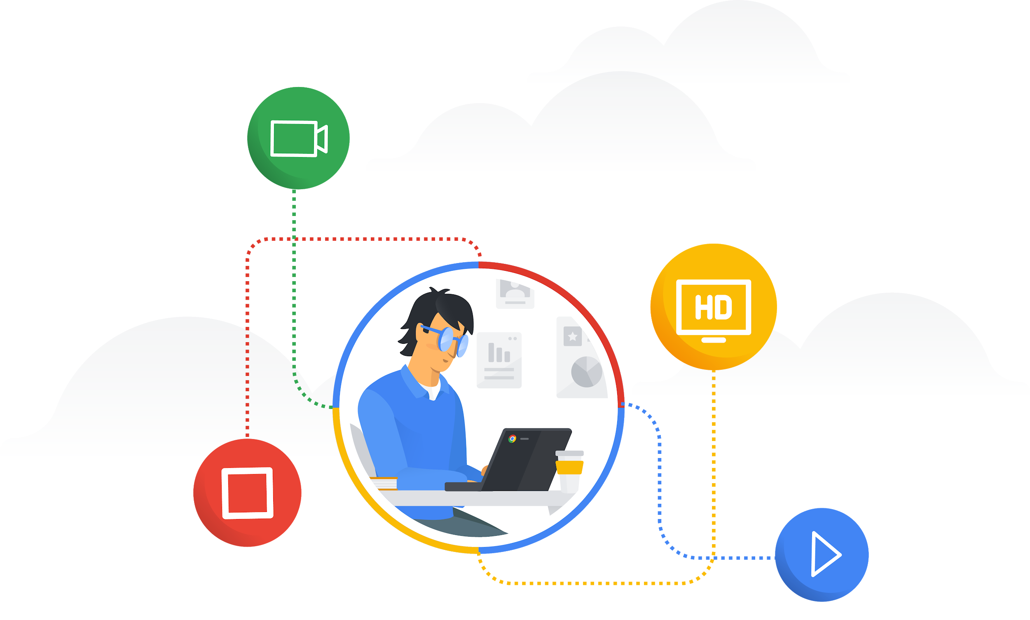
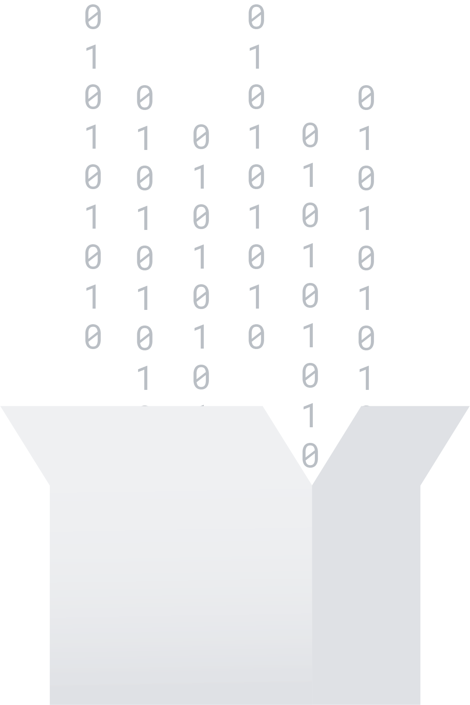
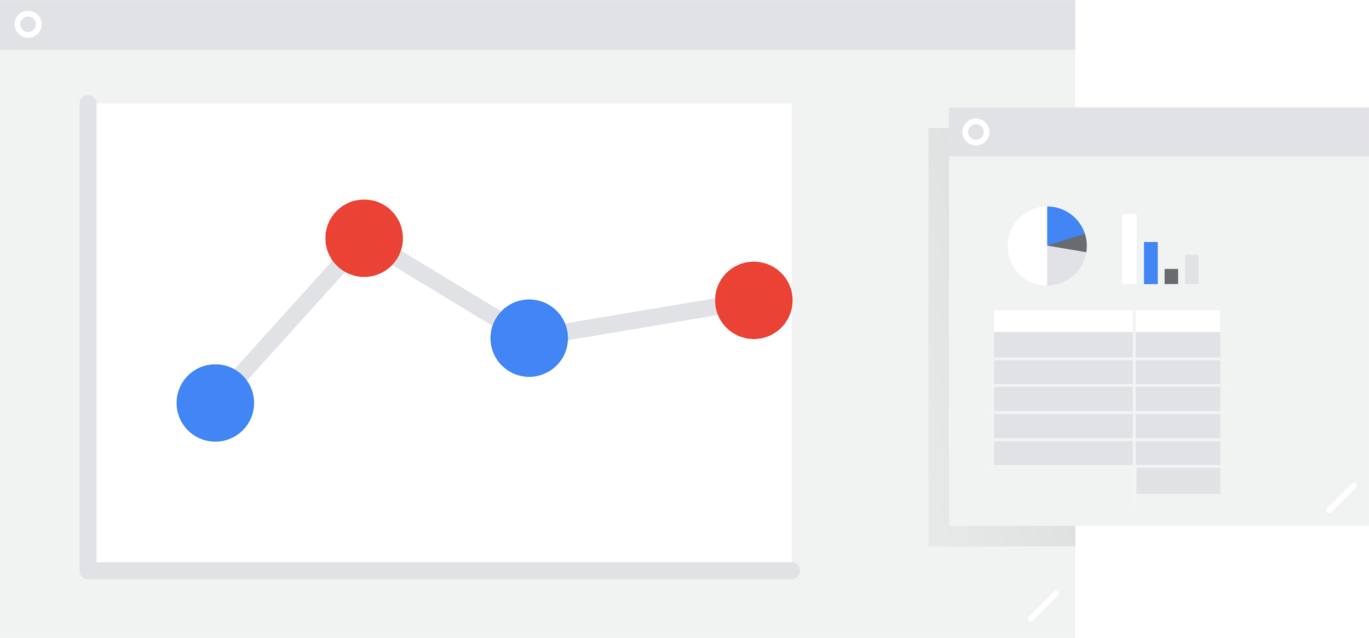
What is Big Data?
Volume
Variety
Velocity
Notes:
Big data has three main characteristics:
Volume: The volume of data is very high such as in petabytes or exabytes.
Variety: Data might be structured (like relational data) or unstructured (like videos, images).
Velocity: The velocity of incoming data is very high, for example clickstream data and sensor readings.

Slide 35
Big Data Challenges
Ingest
Store
Process and Analyze
Explore and Visualize
Ingest
Store
Process and Analyze
Explore and Visualize
Notes:
The high volume, variety, and velocity of data can be challenging to ingest, store, process, and visualize. Google Cloud Platform has the big data and machine learning technologies that you need to derive business intelligence from data.

Slide 36
Lab 4: Rent-a-VM to Process Earthquake Data
Objectives
Create a Compute Engine instance with the necessary access and security.
SSH into the instance.
Install the software package Git (for source code version control).
Ingest data into the Compute Engine instance.
Transform data on the Compute Engine instance.
Store the transformed data on Cloud Storage.
Publish Cloud Storage data to the web.

Slide 37
Introduction to Docker

Slide 38

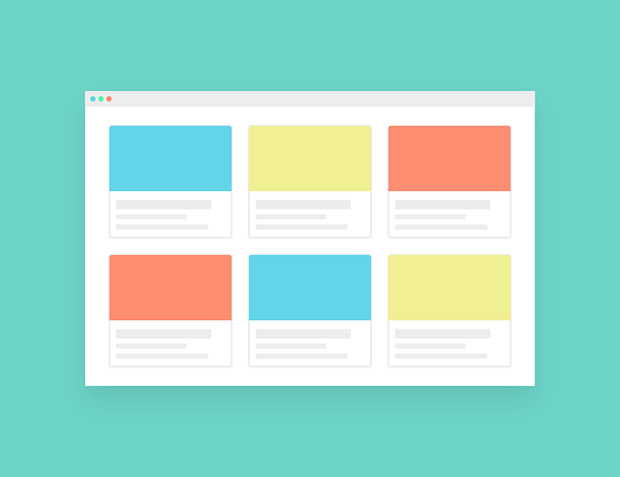
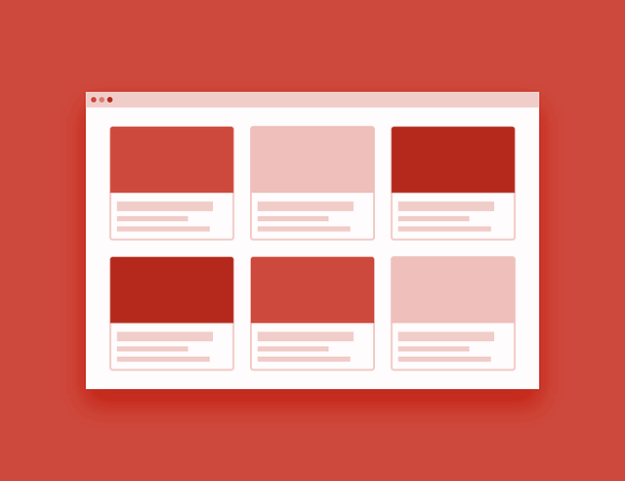
App Environment Inconsistency
The app works on my development machine but breaks in production!
Development Environment
Nginx 1.15
SQLite
Test and Production Environments
Nginx 0.4
MySQL
Notes:
Inconsistencies in the development and production environments can result in your application working well in your development environment but failing to deploy or run optimally in the staging and production environments. For example, your local development environment might be running Nginx 1.15 and SQLite but your test and production environments might be running Nginx 0.4 and MySQL. Even if all environments are running the same types of software, they might be running different versions of the software.
Errors caused by differences in the environment can be difficult and time-consuming to troubleshoot. The inconsistencies affect the overall reliability of your application releases.

Slide 39
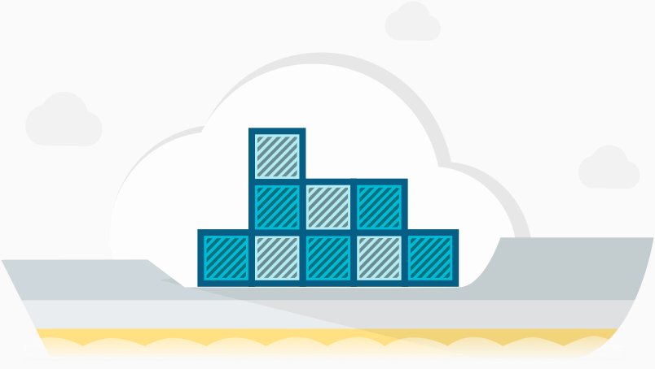
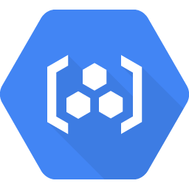
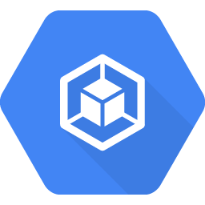
Container, Container Registry, and Kubernetes
Docker Container image
Application binary
Operating system
Tools and libraries
Container Registry
Private Docker repository for your Docker container images
Kubernetes Engine
Kubernetes orchestrates compute, network, and storage on behalf of your application
Kubernetes Engine is a managed service for Kubernetes. It enables rapid application development.
Notes:
Docker Container Image
To create repeatable and reliable deployments, consider packaging your cloud-native application as a Docker container image.
The container image for your application is a complete package that contains the application binary and all the software that is required for the application to run. When you deploy the same container image on your development, test, and production environments, you can be assured that your application will perform exactly the same way in each of these environments.
Container Registry
Container Registry is a private Docker repository for your Docker container images.
Kubernetes Engine
Kubernetes is an open source platform that orchestrates compute, network, and storage on behalf of your application.
Kubernetes Engine is a managed service for Kubernetes. Kubernetes Engine enables rapid application development and iteration by making it easy to deploy, update, and manage your applications and services.

Slide 40
Lab 4: Introduction to Docker
Objectives
How to build, run, and debug Docker containers
How to pull Docker images from Docker Hub and Google Container Registry
How to push Docker images to Google Container Registry

Slide 41
Additional Resources
Build a powerful data backend for mobile and web
Kubernetes
The Illustrated Children's Guide to Kubernetes
Manage Containerized Apps with Kubernetes Engine
Stackdriver
Monitor Health of All Your Cloud Apps with Google Stackdriver

Slide 42
Prepare yourself for careers in a cloud-first world!
Google Cloud career readiness program

Slide 43
You are on your way!
Complete the remaining labs
GCP Essentials quest qwiklabs.com/quests/23. Earn your online badge and one additional month of free access to Qwiklabs.
Share your Qwiklabs completion badge
On social media. Go to: google.qwiklabs.com/dashboard and click “View Public Profile” and our social media hashtag: #CloudStudyJam19
Decide on additional badge(s)
you will go for from google.qwiklabs.com/catalog. Remember that your free Qwiklabs access has an expiration date.
Get Career Ready
Work with your institution to apply for the Google Cloud career readiness program.
Notes:
You have completed four labs and you now have a good basic understanding of Google Cloud Platform. Congratulations, well done! From here on you will pick your own path and continue at home:

